Slide 1

MAGICBRICKS-Company Business Case
BY
BINNY KAUR(110114712)
SAIRAM KUMARAN(110119864)

Slide 2
ABOUT
COMPANY
2022
Early-age startup backed by investors .
MagicBricks is a real estate company. Our online platform provides a deep coverage of real estate market and property trends in major cities of Canada .
Services
Home Loan Deals
Tax planning
Risk Assessment
Financial Planning
+ 2000
Customers across Canada.
+ 500
New Properties.
+100
Upcoming Projects

Slide 3



MISSION , VALUE & VISION
MISSION
VALUE
VISION
Empowering Windsor's real estate success through data-driven insights.
Transforming Windsor's real estate landscape through advanced analytics and innovation.
Integrity, Excellence, and Client-Centricity at our core

Slide 4

HOUSE PRICE PREDICTION AND PERSONALISED HOUSE RECOMMENDATION
Problem Statement/Objective
Predict the price of acquired properties using Random Forest algorithm.
Selecting ideal home for a client based upon their requirement/criteria using Analytical Hierarchy Method.
MagicBricks
Opening doors to your dream home
LOCATION : WINDSOR

Slide 5
PROPOSED BUSINESS CASE MODEL
DATA SOURCING
Acquired house prices dataset of the city of Windsor, Ontario
Using the house prices dataset , build a prediction model to predict the prices of the properties acquired by Magicbricks in the city of Windsor and provide consultation services for personalised recommendation on properties using Analytical Hierarchy Process (AHP) to satisfy our client’s expectation.
DATA CLEANNING and ENGINEERING
Visualise data to analyse and handle missing values , outliers and data transformation
BUILDING A PREDICTION MODEL
Build a prediction model using random forest regression and source dataset of the prices of Windsor properties as the training set
BUILD A PERSONALISED RECOMMENDATION TOOL USING AHP PROCESS
Using AHP , consult the best alternatives from the evoked set as per our client’s requirements

Slide 6




PREDICTION MODEL FLOW
Importing Libraries & Dataset
Data Pre-processing
Exploratory Data Analysis
Data Cleaning
Splitting Data into Training and Testing
Train the model and test accuracy
Our Random Forest model on testing had an accuracy of 82%

Slide 7
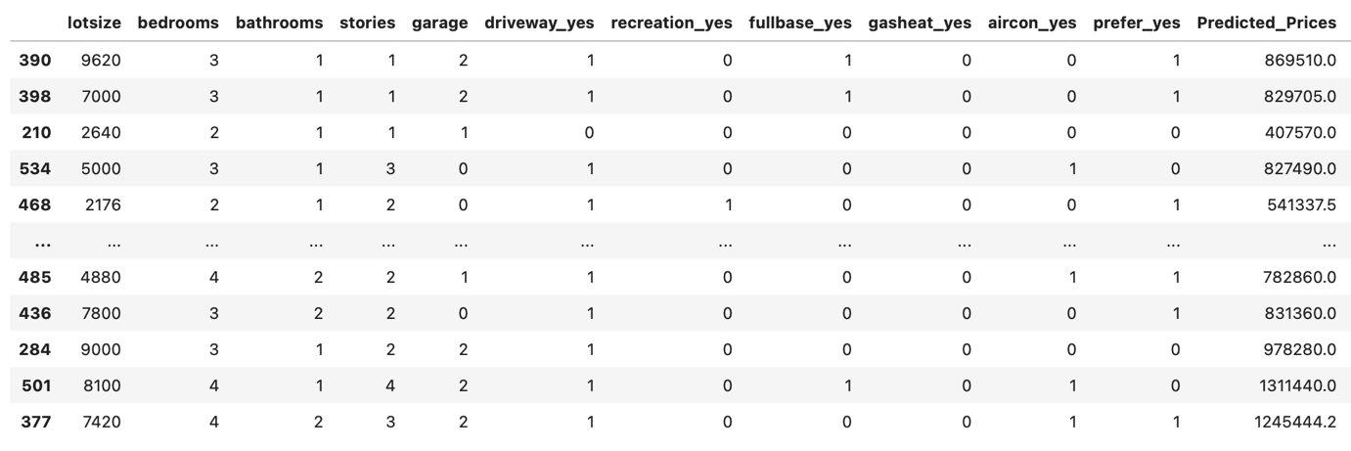
PREDICTED PRICE OF 110 PROPERTIES

Slide 8


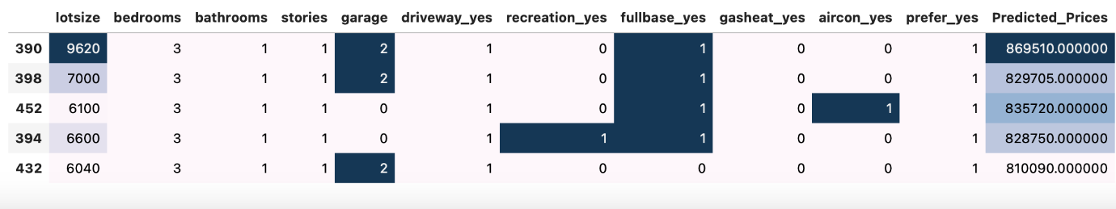
CLIENT REQUIREMENT
New Acquired Property.
Price should be 90,000 $
Single- story house.
Further subjective attribute criteria
Out of 110 new properties only 5 properties justify their requirement

Slide 9
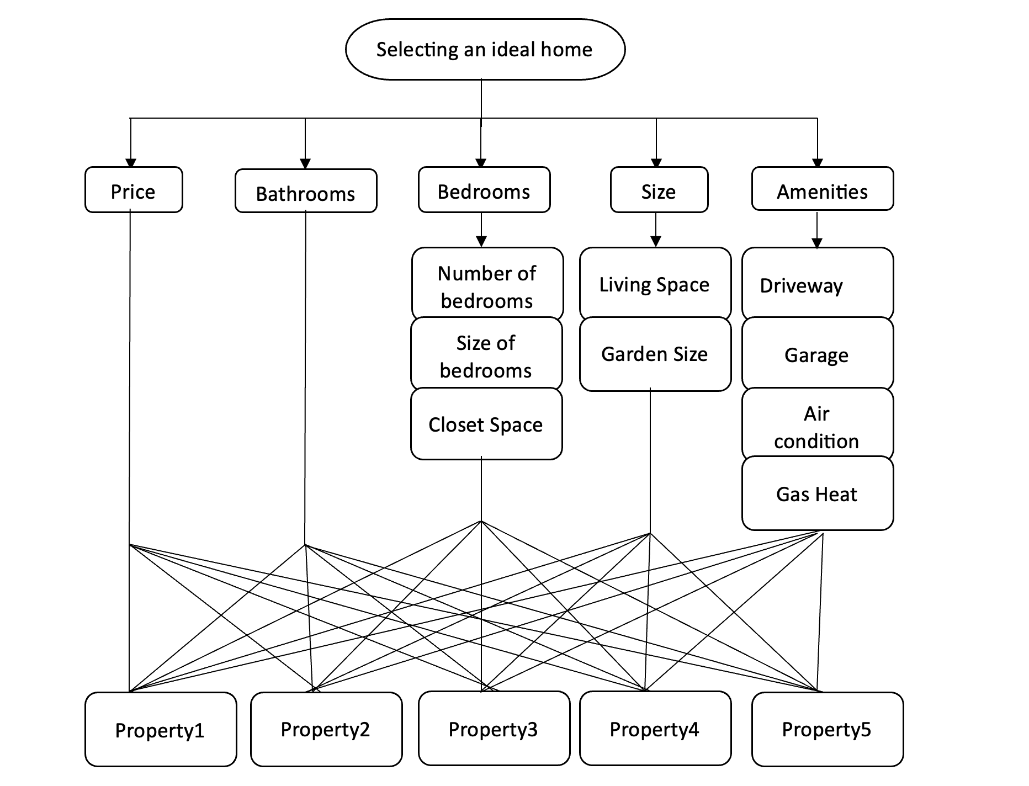
Proposed AHP Model

Slide 10
STEPS TO IMPLEMENT AHP MODEL
Criteria and sub criteria normalize
Calculate the global weights
Alternative pairwise matrix normalize
Final Alternatives priority weights
Using the priority eigen values of the criteria and sub criteria calculate the global weights of the sub criteria and criteria using the relative and local weights
Using global weights calculated for criteria and sub criteria and the priority eigen values of the alternatives weighted against it to calculate the priority weights (or) priority percent of alternatives
Normalize the criteria and sub criteria pairwise weight comparisons and extract the priority eigen values of each of them
Using the alternatives pairwise matrix calculate the normalize matrix and extract the priority eigen values of the set of alternatives

Slide 11
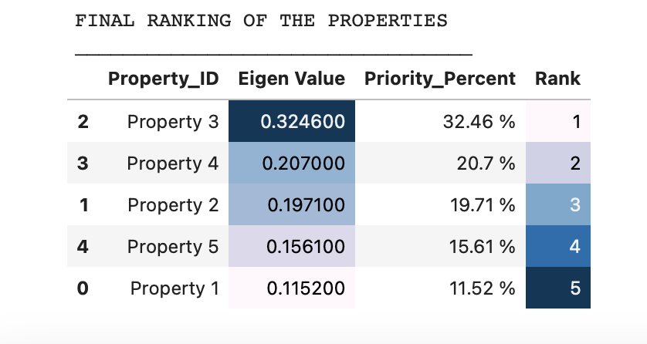
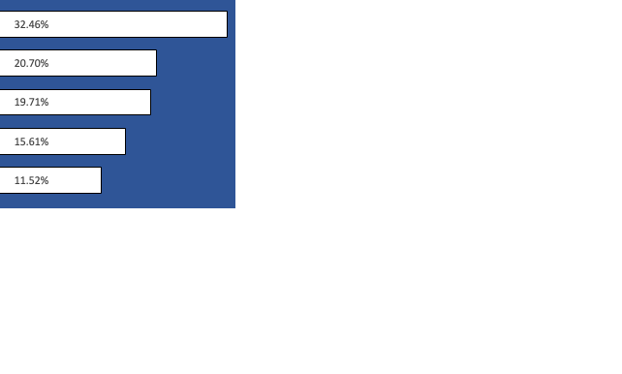
Results of AHP Process

Slide 12
OUR
SERVICES
These services collectively aim to empower clients with valuable insights, data-driven recommendations, and strategic guidance to make successful real estate decisions in the city of Windsor.
Market Research
Property Portfolio Optimization
AHP Decision Support
Client Consultation
Conducting in-depth market research to identify trends, opportunities, and potential risks in the real estate market of Windsor.
Assisting clients in optimizing their property portfolios by identifying high-performing properties and recommending strategic acquisitions or divestments.
Applying the Analytical Hierarchy Process (AHP) methodology to compare and prioritize different real estate alternatives based on clients' criteria and sub-criteria.
Offering expert consultation to guide clients through the process of property acquisition, investment, and decision-making.

Slide 13
OUR PRICING PLAN
Standard 200$ Per Month
Basic 100 $ Per Month
Premium 500 $ Per Month
Basic features (plus)
AHP Decision Support
Risk Assessment
Customized Reports
House Price Prediction
Market Research
Data Visualization
Client Consultation (Limited)
Standard features (plus)
Enhanced Client Consultation
Competitive Analysis
Priority Support
Exclusive Insights

Slide 14
CONTACT
CANADA
+1 458 44568
magicbricksca@gmail.com
www.magicbricks.ca

Slide 15
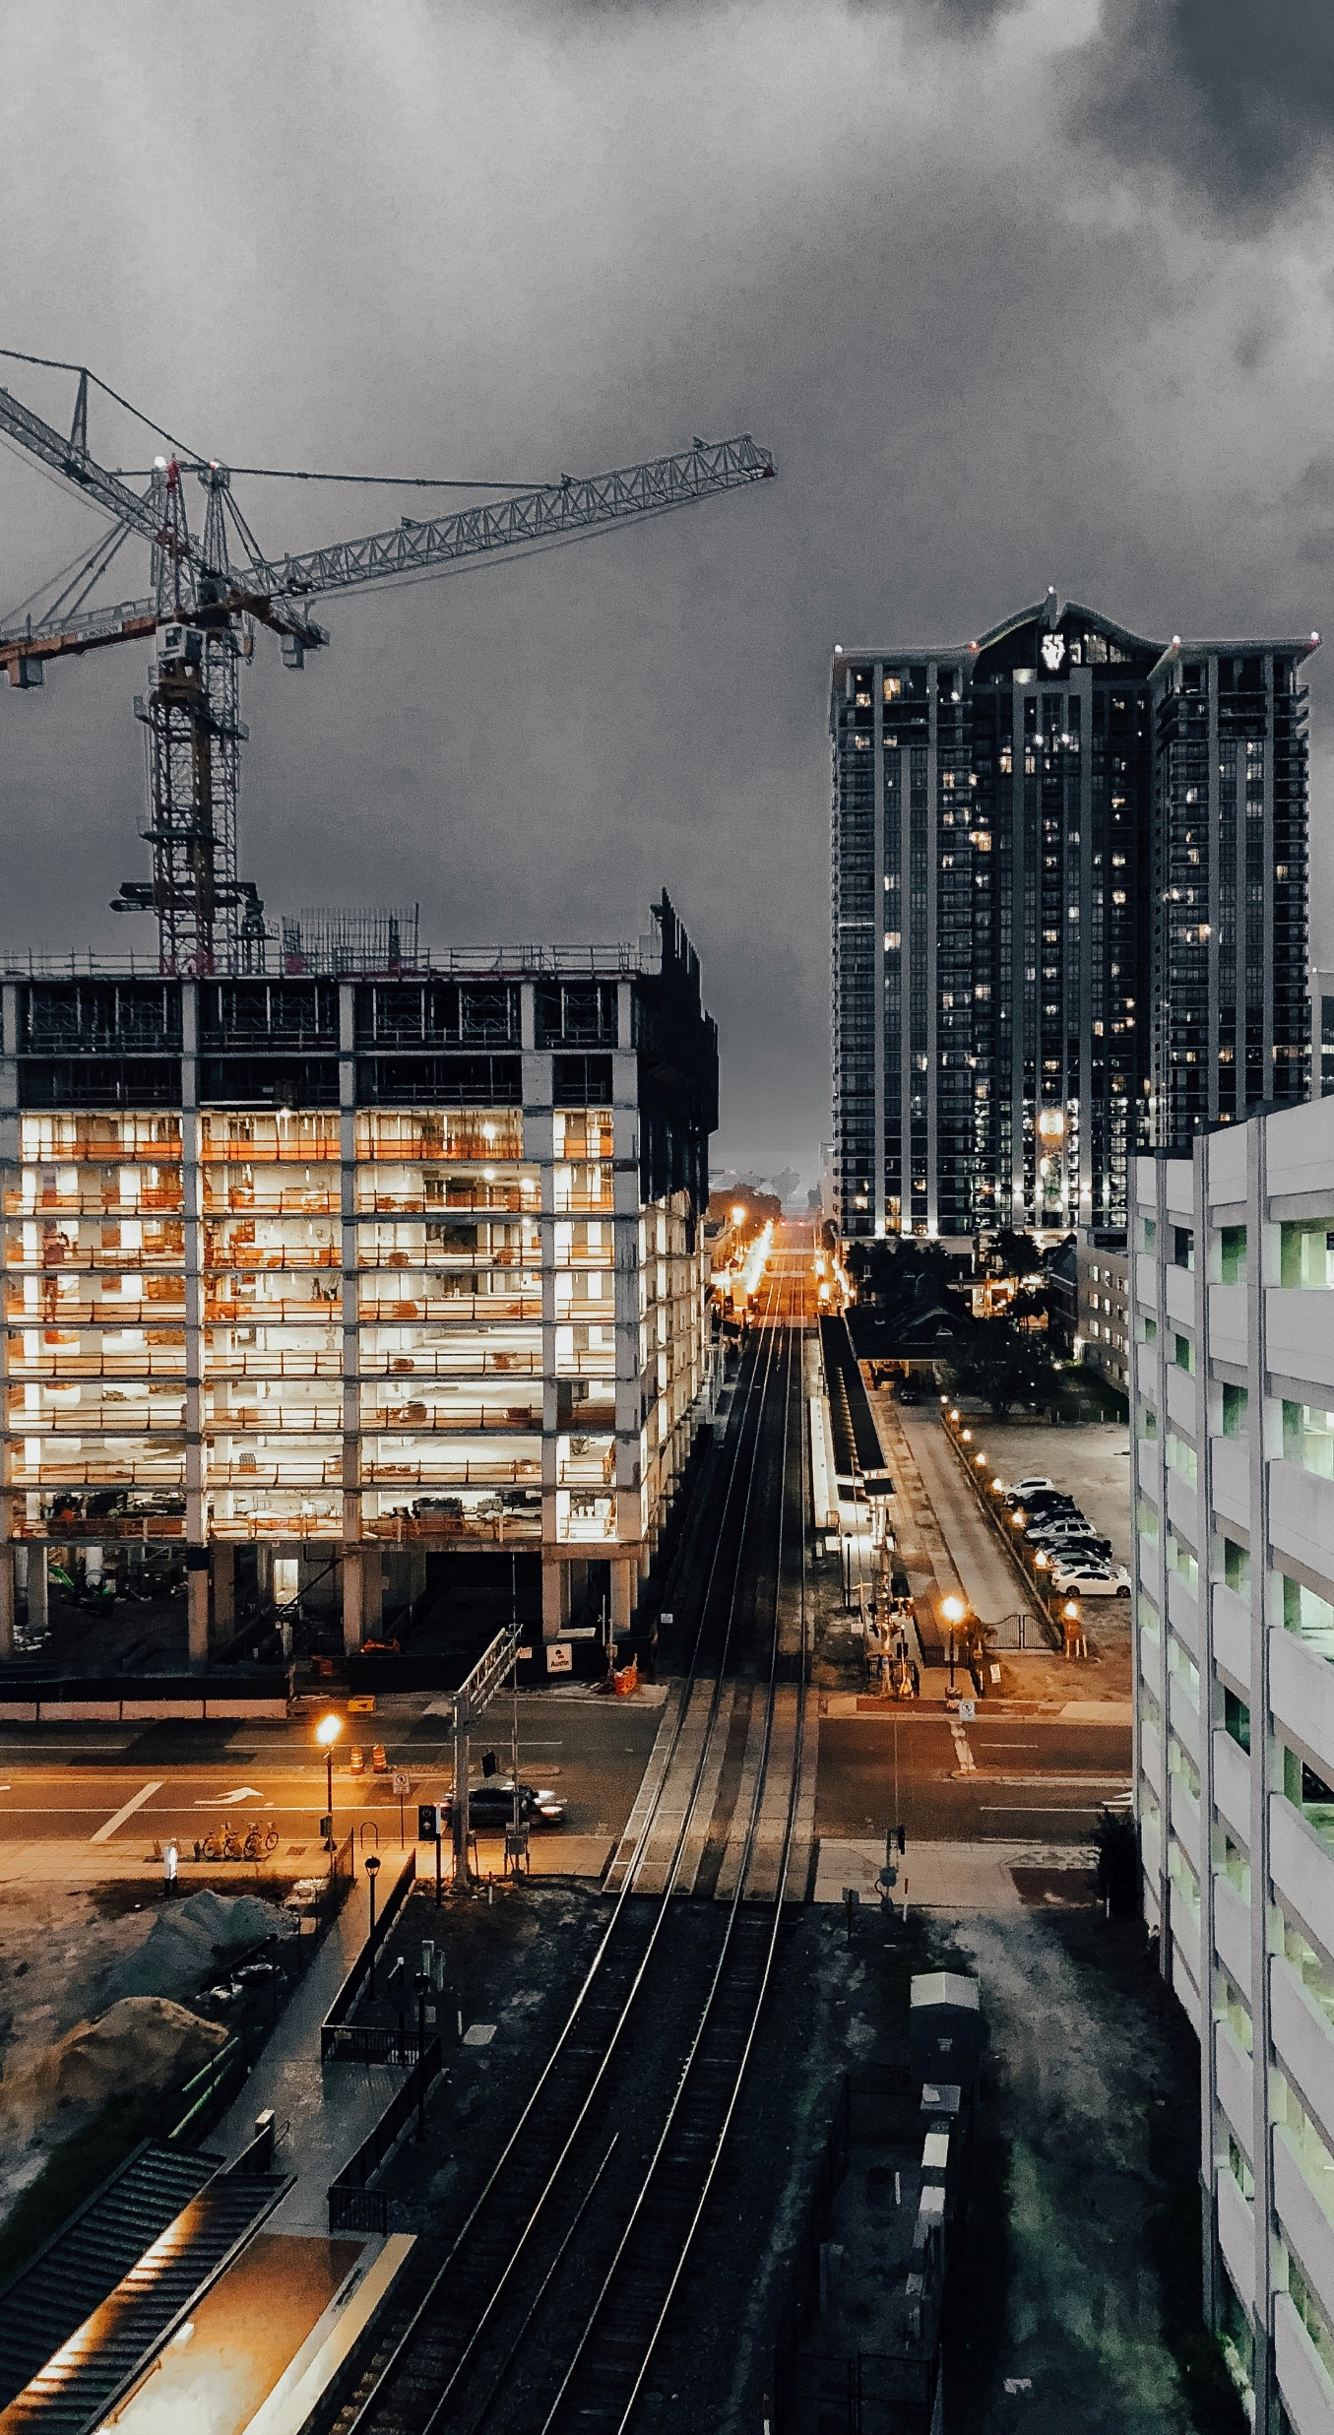
THANK YOU

